Slide 1
Crime Rate Analysis
Beyond Visualization
Team 1
Awais Ahmad Khan (10)
Shah Rukh Rukh Khan (11)
Rod Skoglund (23)

Slide 2
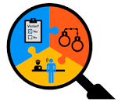


PROBLEM STATEMENT
People that want to move to a new community or be informed while traveling, would like to avoid high crime areas and find the best time to visit a specific area within the Kansas City, Missouri area.
They can enter a zip code, a radius with a date in the past and the application will return all the crimes in that time span. It will also provide a safety measure which varies with time.

Slide 3
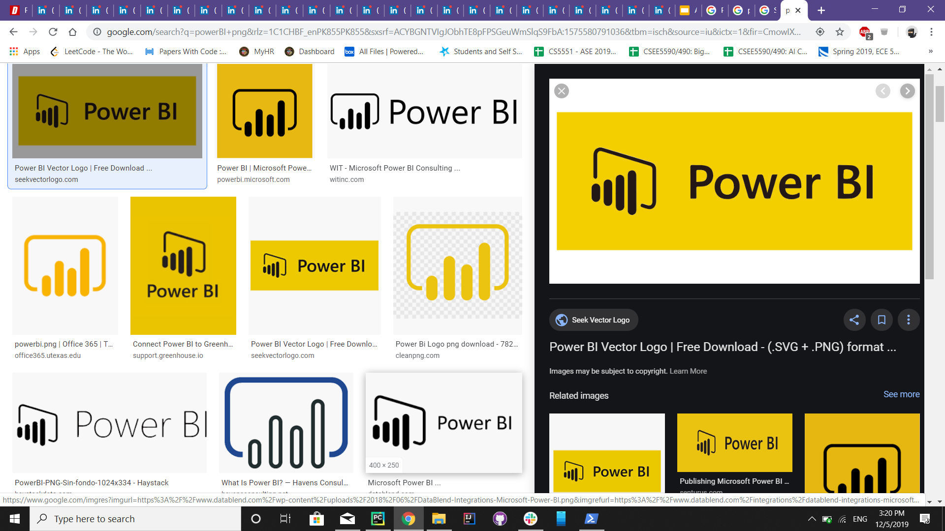
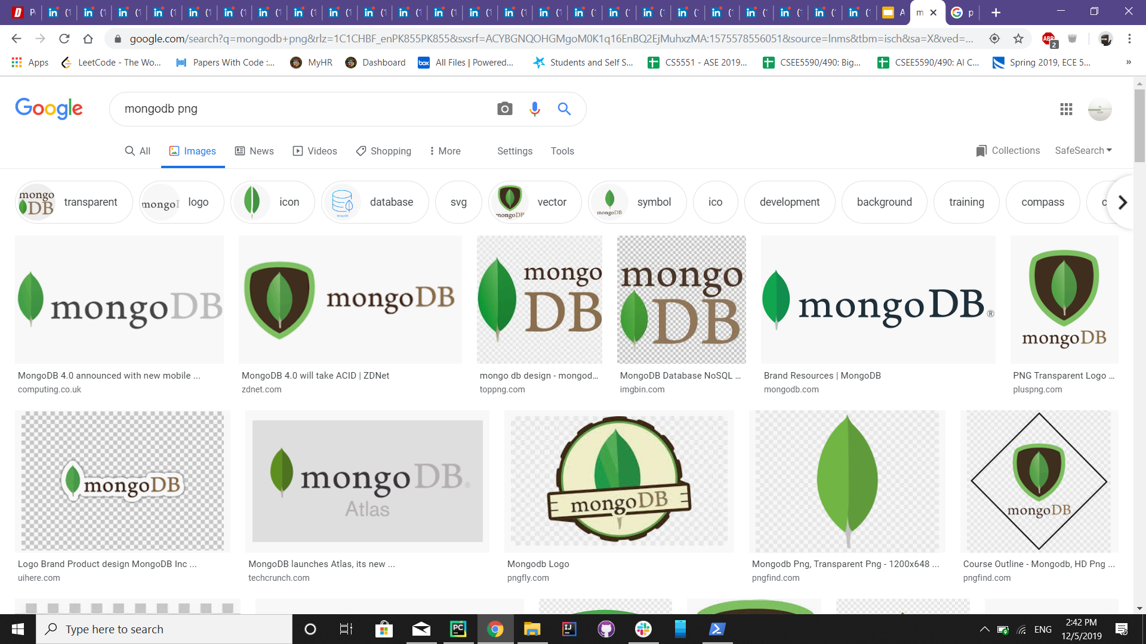
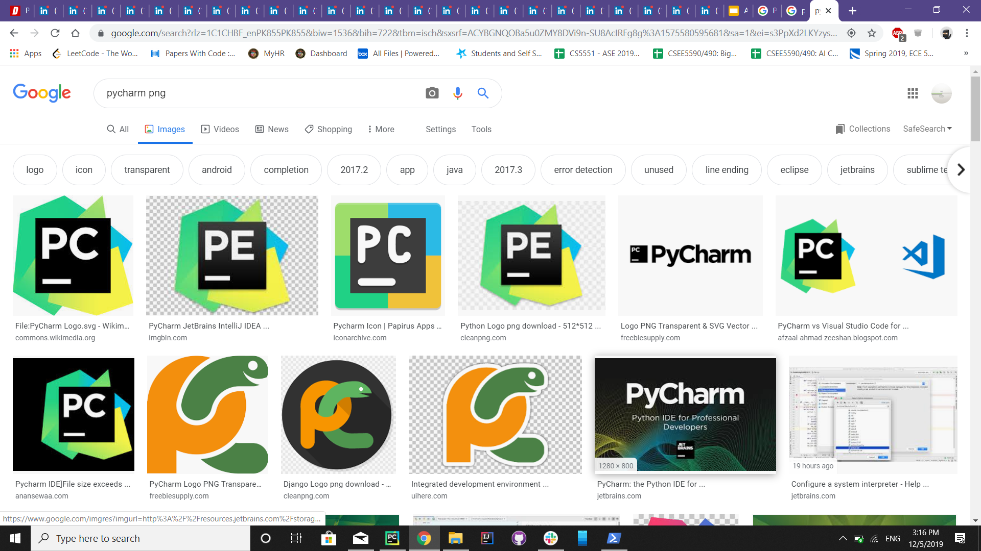
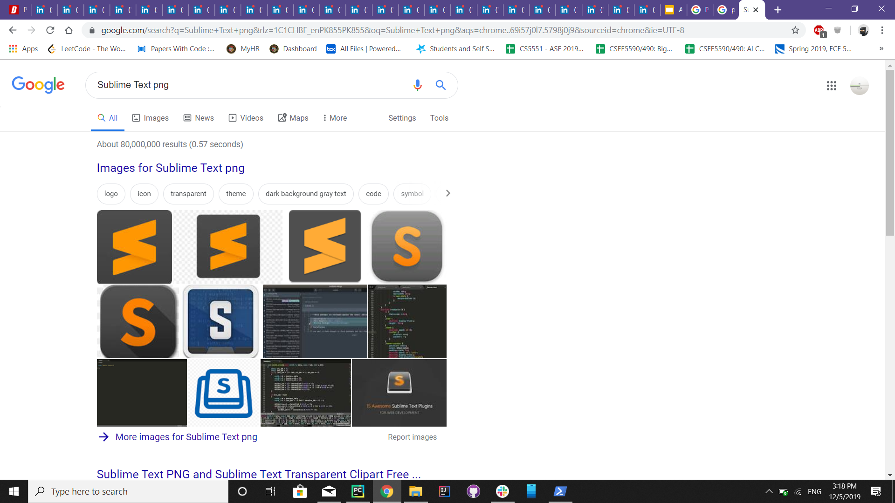
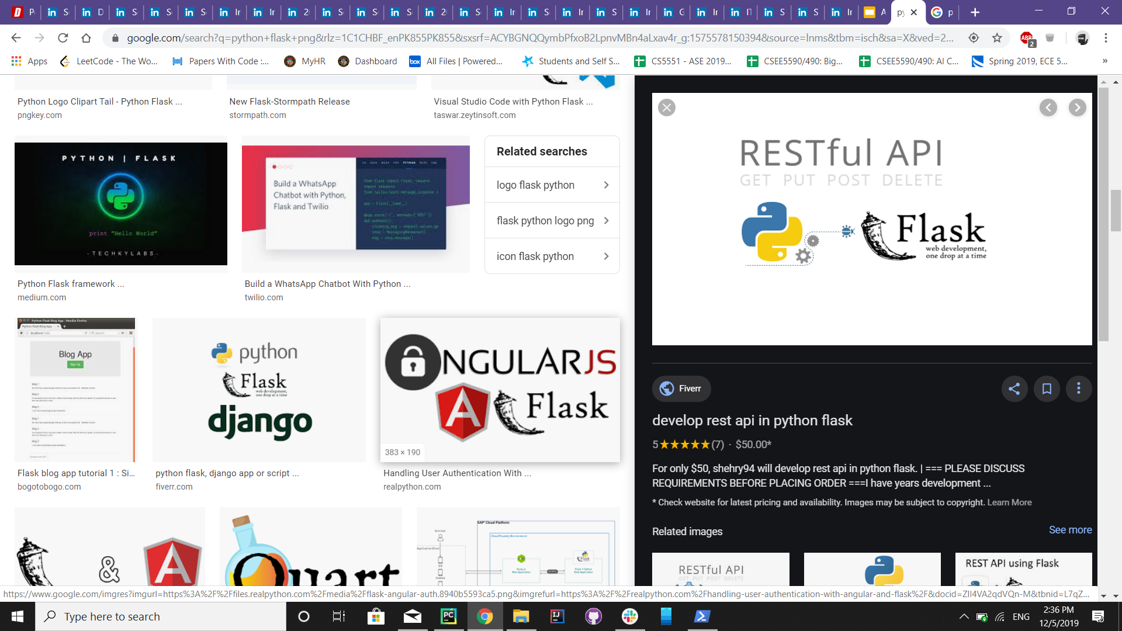
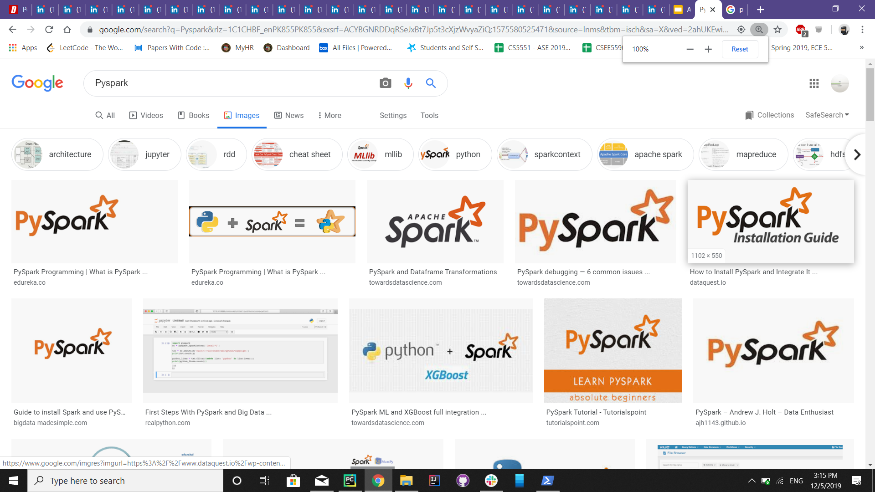

Technologies Used

Slide 4

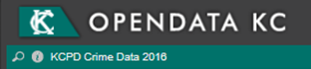
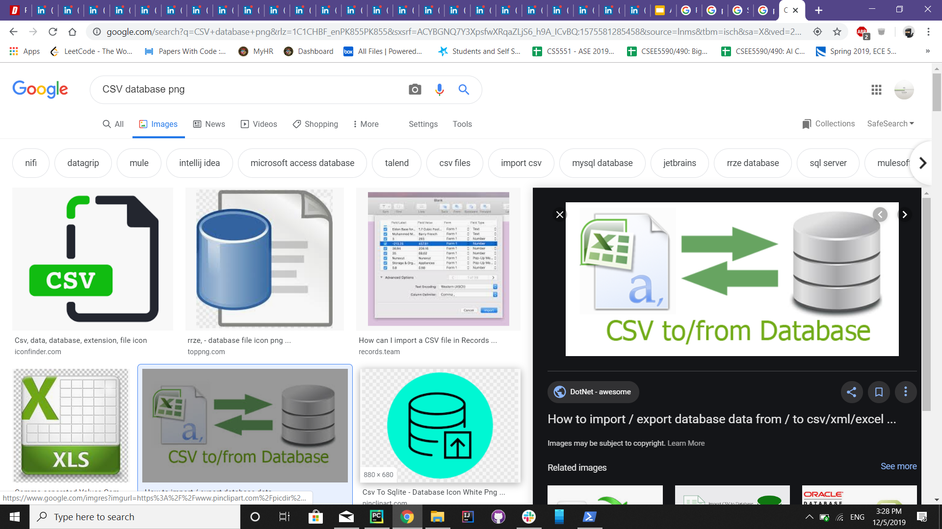


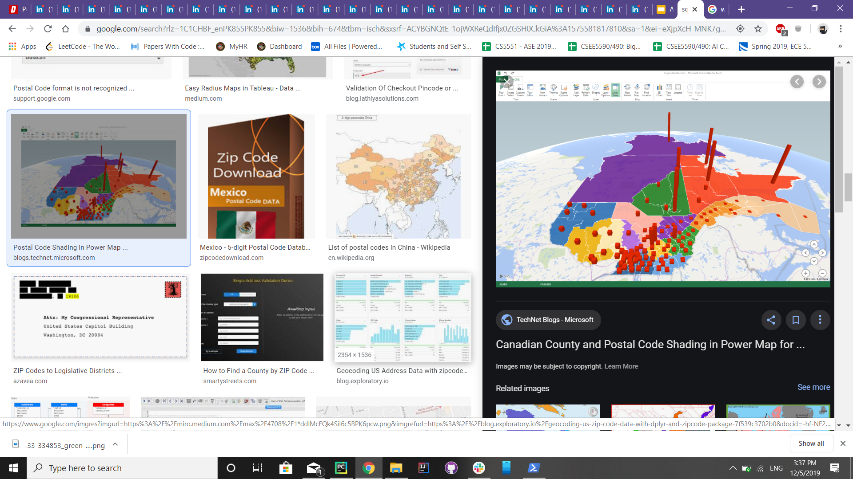

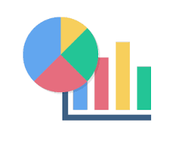
ARCHITECTURE

Slide 5
Data Behind the Scenes
The Data that is driving this application is from the OpenData KC - KCPD Crime Data API’s (https://data.kcmo.org/browse?q=crime&sortBy=relevance). We investigated several sites and found this to be the most useful for our Application.
This data stores annual data on seperate sites. Unfortunately, there is a lot of errors in the data, which required cleaning to make it useful. We had to eliminate 00000/99999 zip codes, Latitude-Longitude info that was out of the target data, etc.
The data was initially pulled down into a CSV/Excel file where the individual years (each year has its own Dataset/API) were combined. We added additional rows to enable us to eliminate multiple rows for each individual crime (now each row is its one, unique crime).
We eliminated invalid rows (bad zip codes, no latitude-longitude info, crimes that are not in the KC Metro area (Oklahoma, Florida, Iowa, etc.)

Slide 6
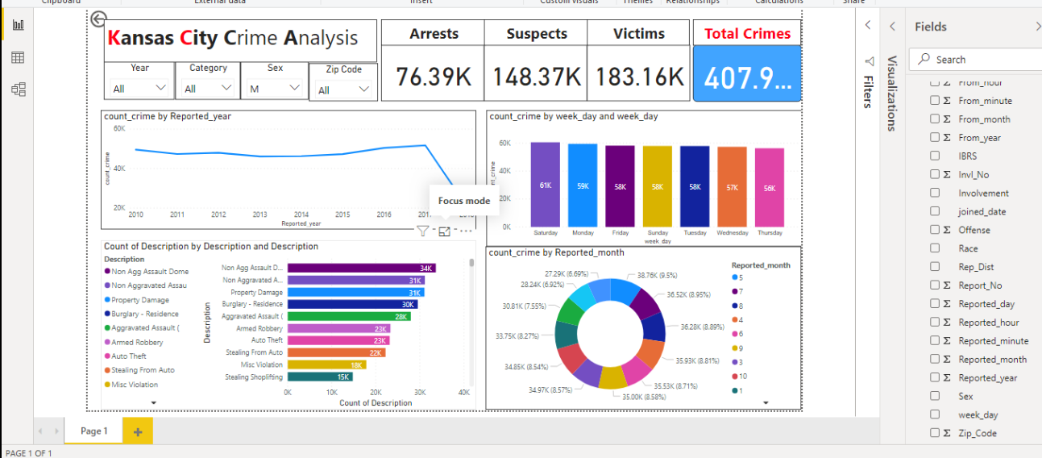

Slide 7
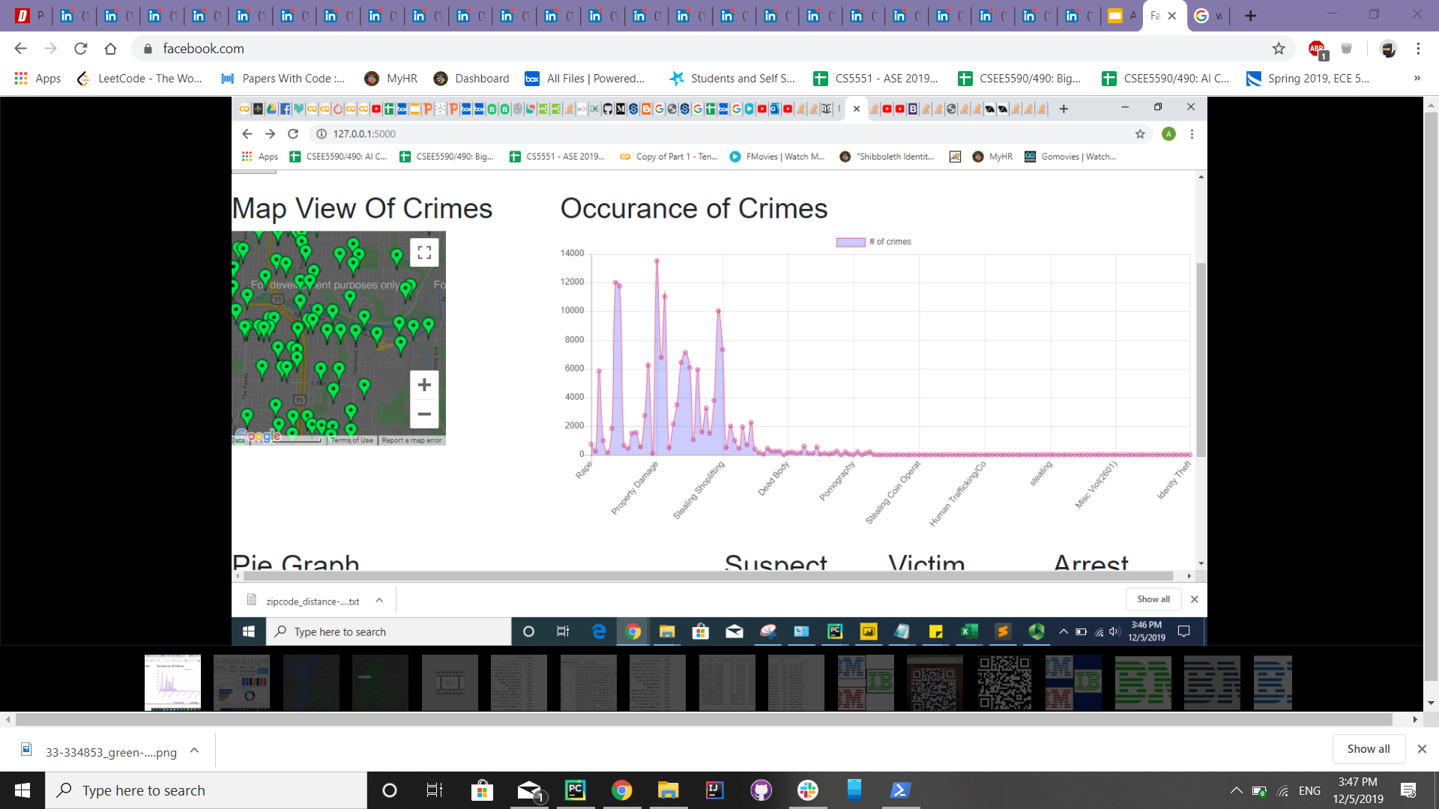
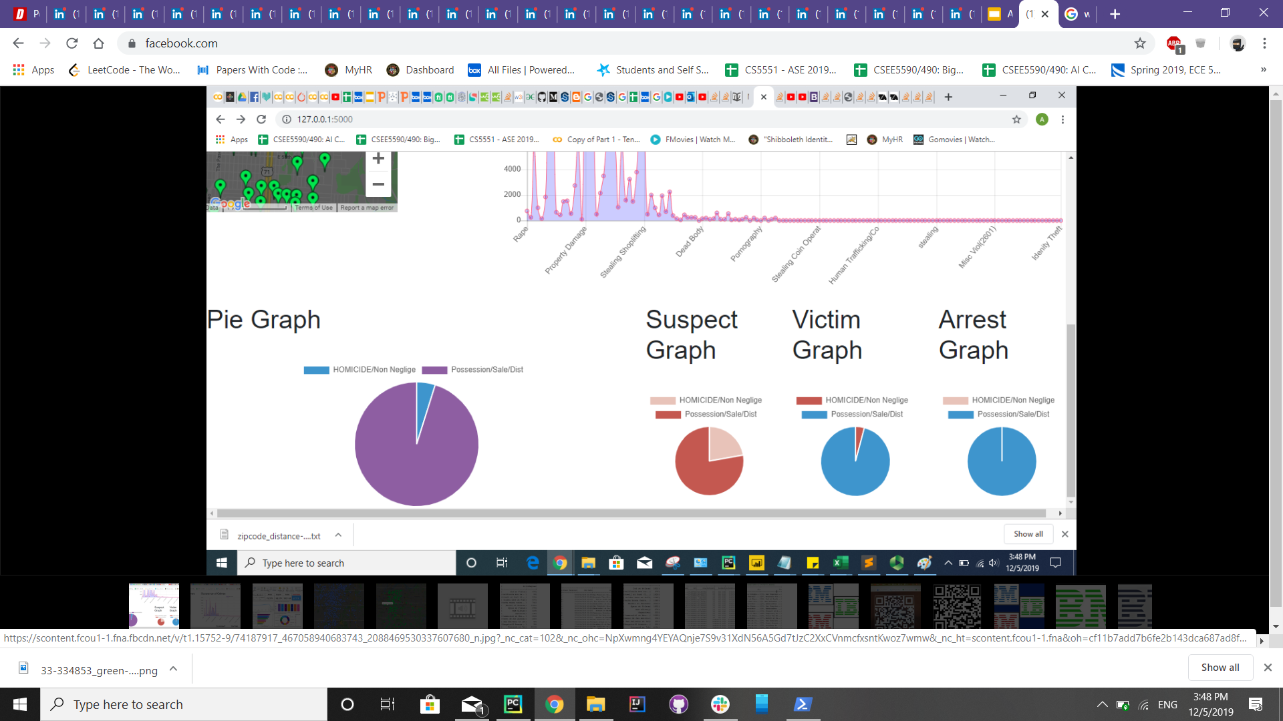

Slide 8
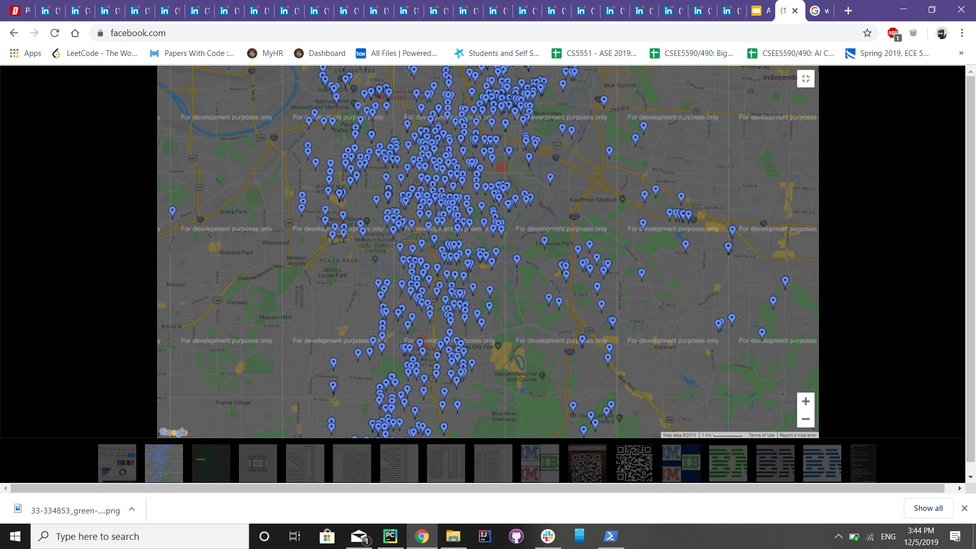
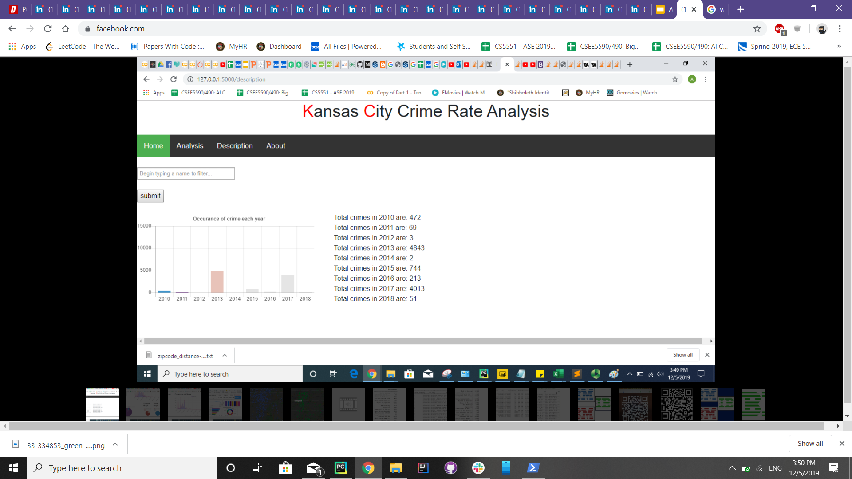
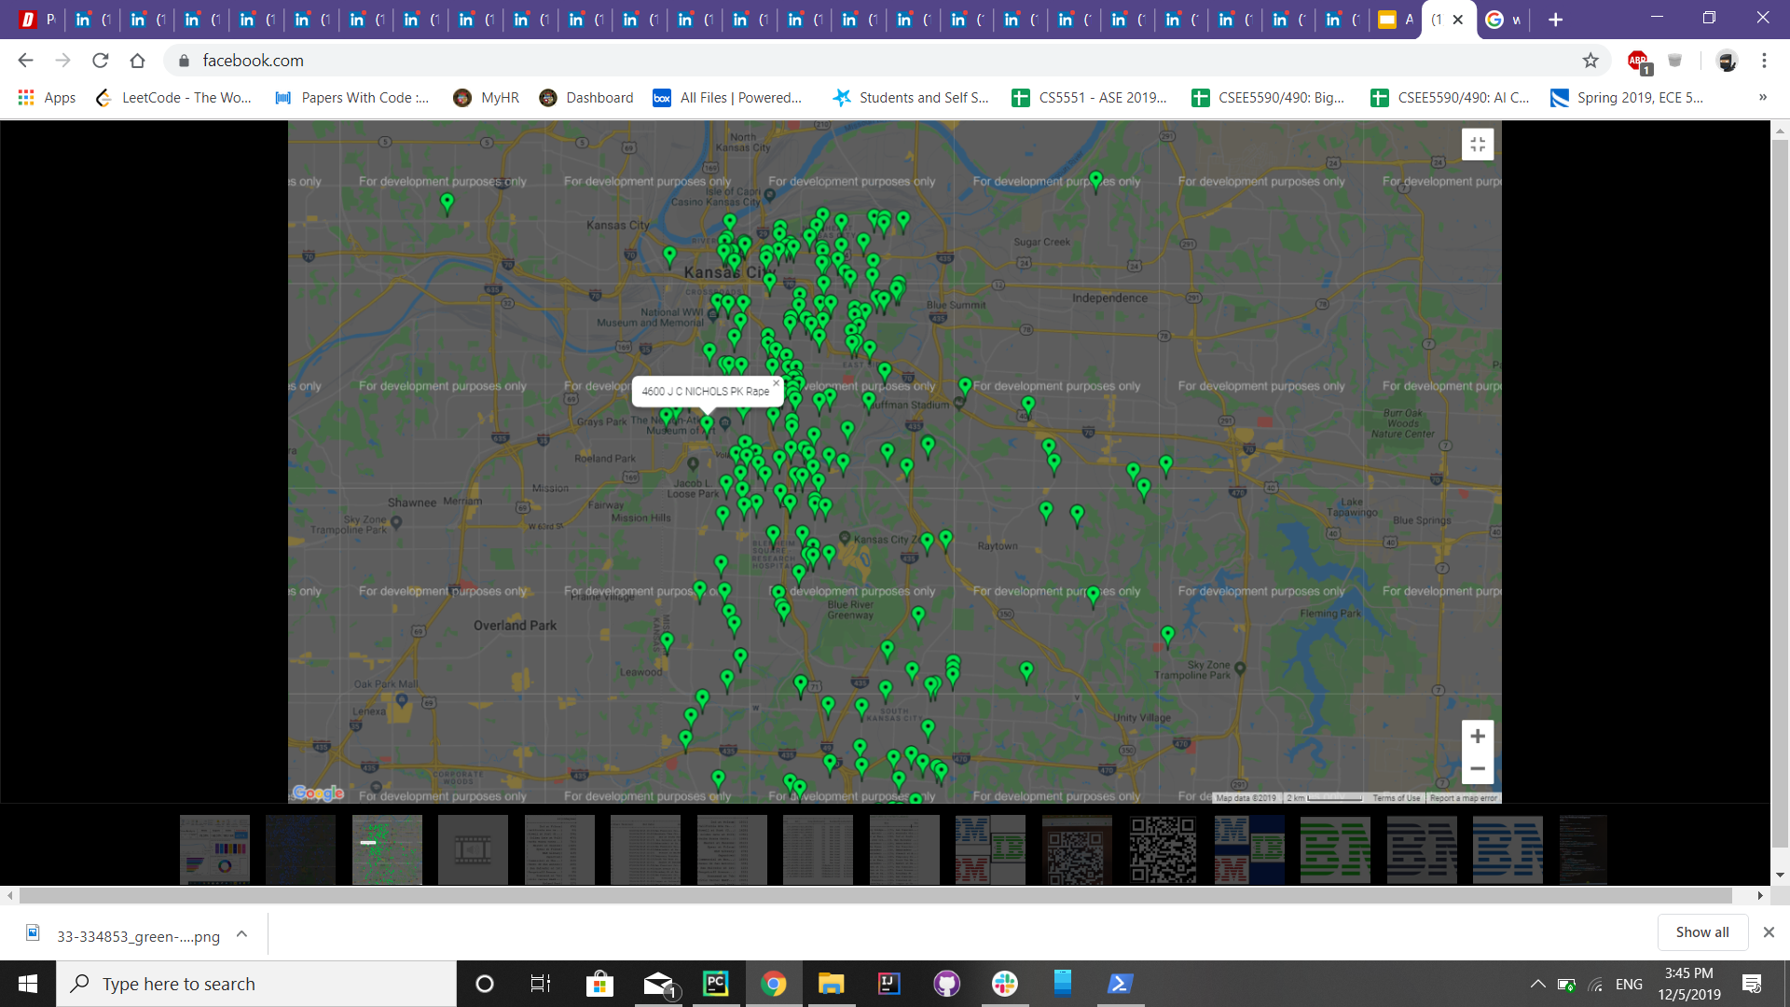

Slide 9
CONCLUSION
We have presented a working Crime Research data application that can help people determine what chances they have of being impacted by a crime in a specific area within the Kansas City, Missouri area.
We found that every year, the crime has decreased and that the most crimes happen on Monday’s and least on Sunday’s - We recommend doing things on Sunday’s

Slide 10
Video
Click for Video Demonstration

Slide 11

Any questions ?
Thank
You

